Slide 1
Strong independent people
18 Reflexive Pronouns

Slide 2
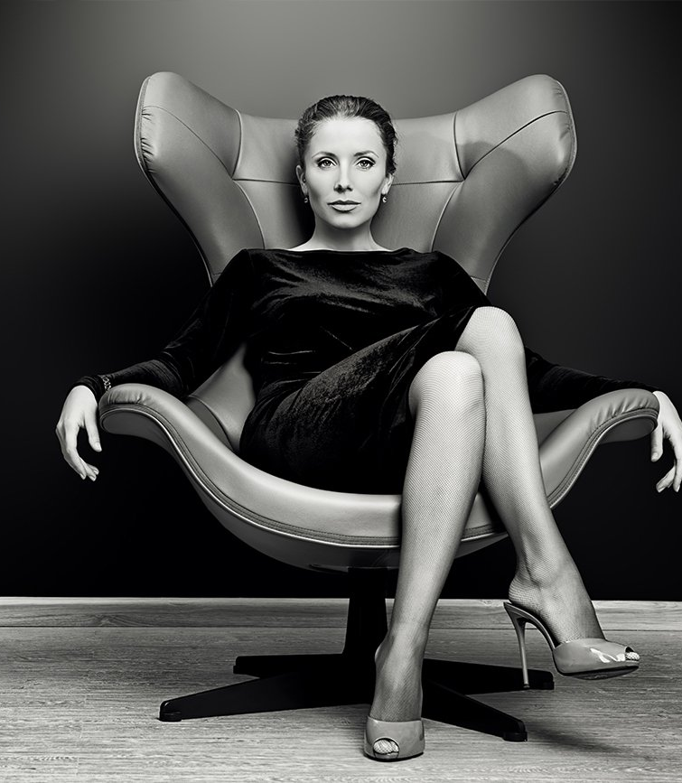
Strong independent people
What do you do to feel strong?
What do you do to feel independent?
Have you ever taught yourself a skill?
Have you taught someone something?

Slide 3
Reflexive pronouns
We use reflexive pronouns when the object and subject of a sentence are the same.
He taught himself how to cook.
We use them to emphasize the subject.
I carried the suitcases myself. (I carried them, and not someone else.)
We use by + a reflexive pronoun to talk about something the subjects did alone.
They fixed the car by themselves. (No one helped them.)
Personal pronoun | Reflexive pronoun
I | Myself
You | Yourself
He | Himself
She | Herself
It | Itself
We | Ourselves
You | Yourselves
They | Themselves
Notes:
Practice video
https://www.youtube.com/watch?v=5geONv9xEnQ

Slide 4
Make sentences
Subject | Activity | Alone? | Reflexive Pronounn
I | baked the cake
You | carried the suitcase
We | fixed up the room |  | Myself
They | put up the shelf |  | Yourself
He | dressed |  | Himself
The boy | went to the play |  | Herself
Sara | chose this dress | By (optional) | Itself
She | painted this picture |  | Ourselves
My wife and I | open |  | Yourselves
The kids | cooked |  | Themselves
The door | drove
The dog | traveled across Tokyo
Notes:
Extra exercise
https://www.youtube.com/watch?v=KePQPKGNh2M

Slide 5
Complete the sentence
Look, Mom! Julie and I fixed up our room all by ________.
Don’t worry! My suitcase is very light. I can carry it ________.
Hi, Marty! Hi, Carla! Won’t you both come in! Please make ________ at home.
I’ve shown you how to chop up the beef. Now you can add the vegetables by ________.
When Sally went shopping yesterday, she bought ________ a gorgeous new dress.
Tom and Jen love working on their apartment. They fixed up this lovely guest room ________.
Clark is the host of this party. There he is. He’s introducing ________ to all the guests.
You don’t need to switch off the electric toothbrush. After a few minutes, it switches off by ________.
I won’t hire someone to fix my sink. I can do it ________.
Independent people think they can solve everything by ________.
Notes:
1. ourselves
2. myself
3. yourselves
4. yourself
5. herself
6. themselves
7. himself
8. itself
9. Myself
10. themselves

Slide 6
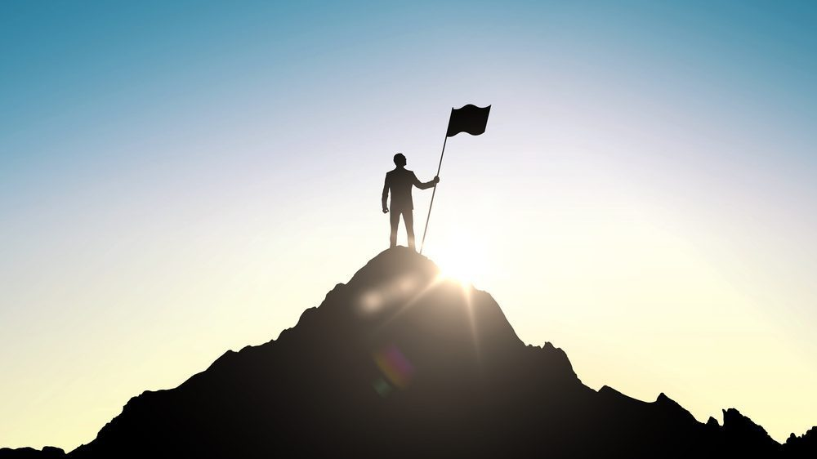
Are you too independent?
Talk with your classmates about:
How often do you see your friends and family?
What keeps you up at night?
Who do you lean on when times get tough?
Do you ever feel lonely?
Notes:
https://www.bolde.com/are-you-too-independent/
Extra practice
https://www.youtube.com/watch?v=KePQPKGNh2M

